Slide 1
The High-School Mathematics(Trigonometry) behind Positional Encoding in Transformer Language Model
Nathan
December 11, 2024

Slide 2
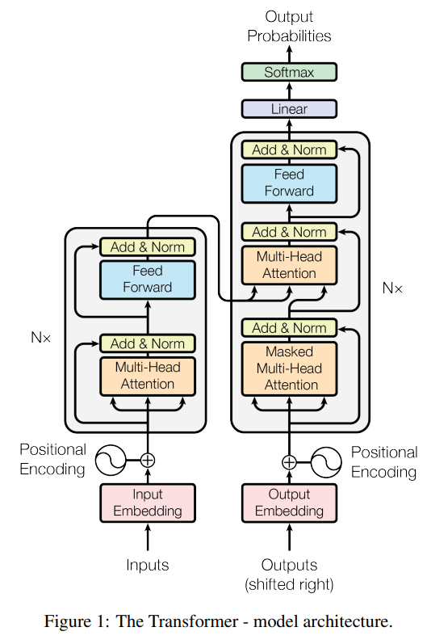

Positional Encoding in Transformer
3.5 Positional Encoding
Since our model contains no recurrence and no convolution, in order for the model to make use of the order of the sequence, we must inject some information about the relative or absolute position of the tokens in the sequence. To this end, we add "positional encodings" to the input embeddings at the bottoms of the encoder and decoder stacks. The positional encodings have the same dimension dmodel as the embeddings, so that the two can be summed. There are many choices of positional encodings, learned and fixed [9].
In this work, we use sine and cosine functions of different frequencies:
where pos is the position and i is the dimension. That is, each dimension of the positional encoding corresponds to a sinusoid. The wavelengths form a geometric progression from 2π to 10000 · 2π. We chose this function because we hypothesized it would allow the model to easily learn to attend by relative positions, since for any fixed offset k, PEpos+k can be represented as a linear function of PEpos.
Source: [1706.03762] Attention Is All You Need

Slide 3
What is and Why Positional Encoding – Let’s Get Ready.
What is ?
Positional encoding describes the location or position of an entity in a sequence so that each position is assigned a unique representation.
Positional encoding is a re-representation of the values of a word and its position in a sentence (given that is not the same to be at the beginning that at the end or middle).
Why?
In many sequence-based tasks, such as natural language processing, the order of elements in the input sequence is crucial for understanding the context and meaning.
Unlike recurrent neural networks, the Transformer architecture processes all input tokens in parallel. Without positional information, the input tokens are treated as a bag-of-words, thereby making it difficult for the model to understand the sequential nature of the input. Therefore, positional encoding is added to the input embeddings to help the model understand the sequential structure of the data and differentiate between elements in different positions.
Criteria
It should output a unique encoding for each time-step (word’s position in a sentence)
Distance between any two time-steps should be consistent across sentences with different lengths.
Our model should generalize to longer sentences without any efforts. Its values should be bounded.
It must be deterministic.
Possible Solutions:
to assign a number to each time-step linearly.
to assign a number to each time-step within the [0, 1] range in which 0 means the first word and 1 is the last time-step.
???
Reference: https://platform.openai.com/docs/api-reference/embeddings/create
https://kazemnejad.com/blog/transformer_architecture_positional_encoding/

Slide 4
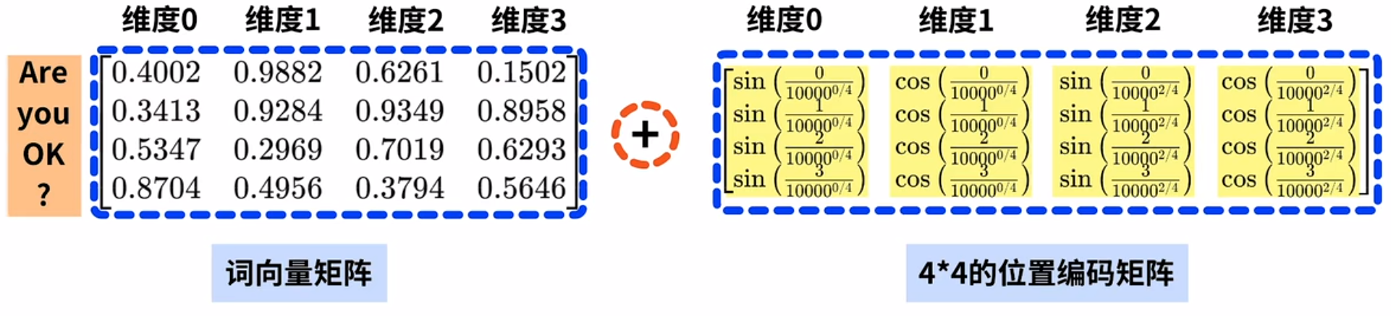
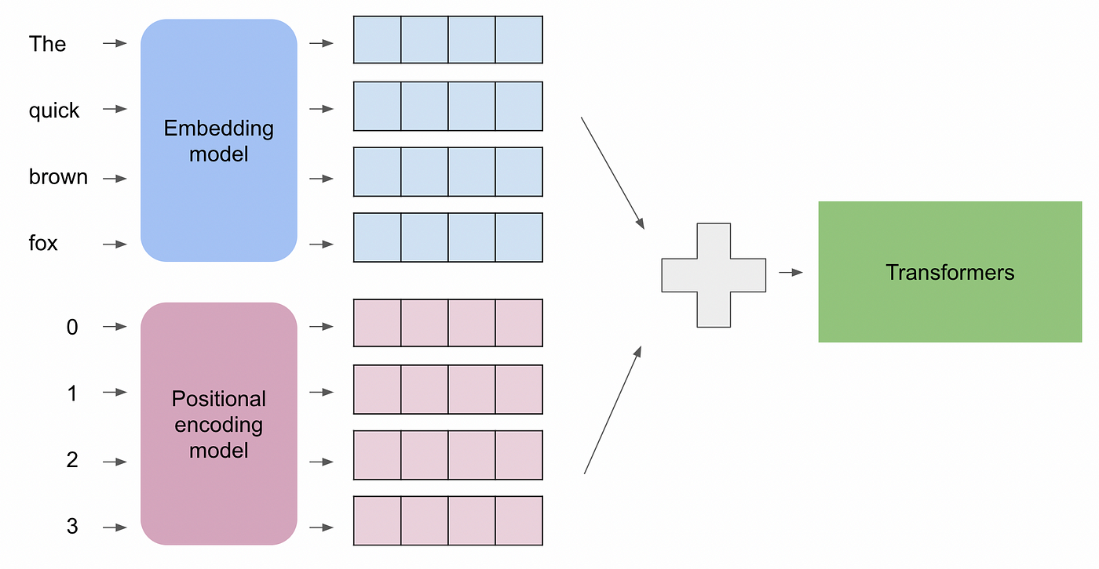
Understand Embedding and Positional Encoding – Let’s Get Ready.
The quick brown fox jumps over the lazy dog.
Reference: https://platform.openai.com/docs/api-reference/embeddings/create

Slide 5
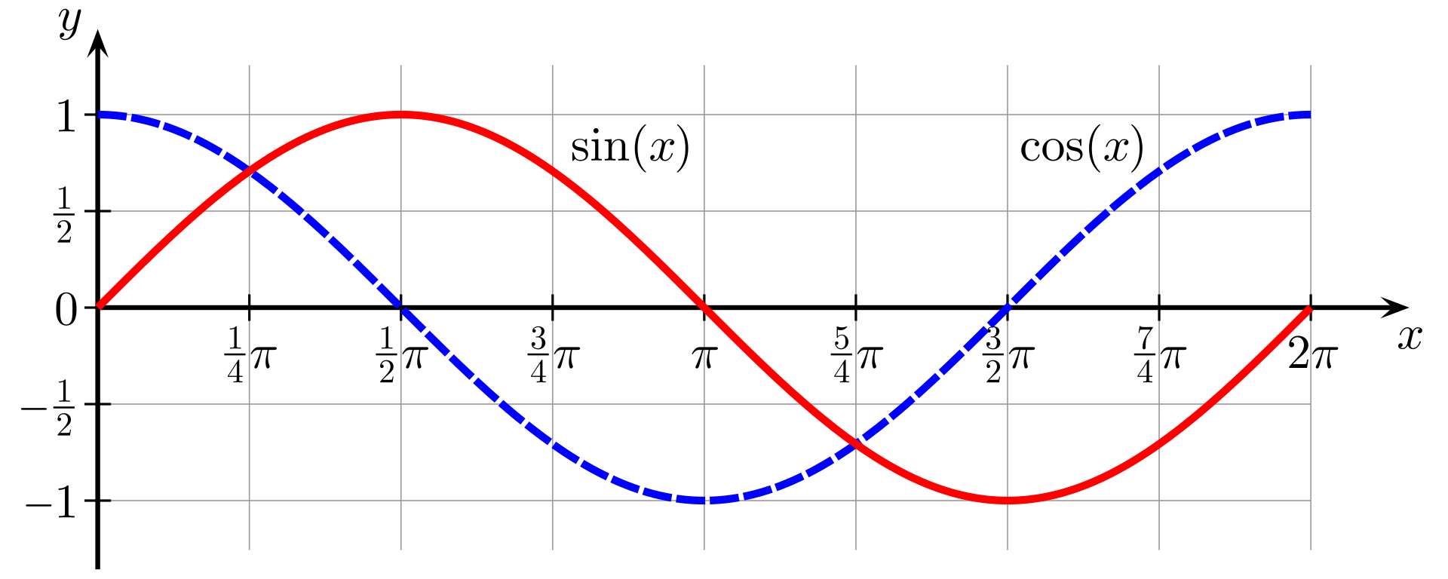
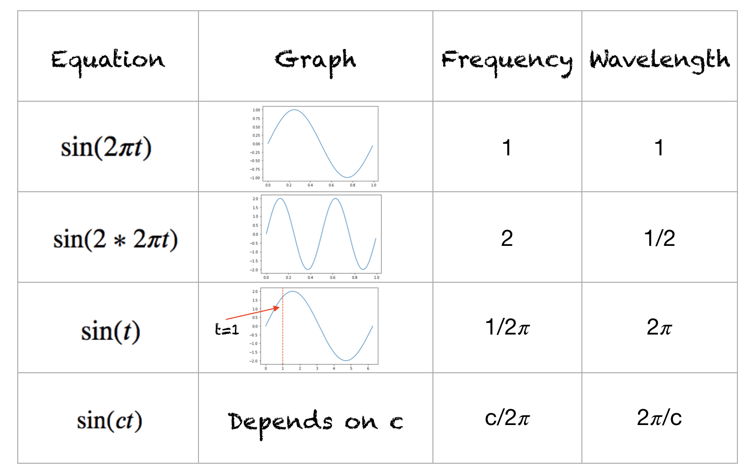
Recall sine and cosine – Let’s Get Ready.

Slide 6
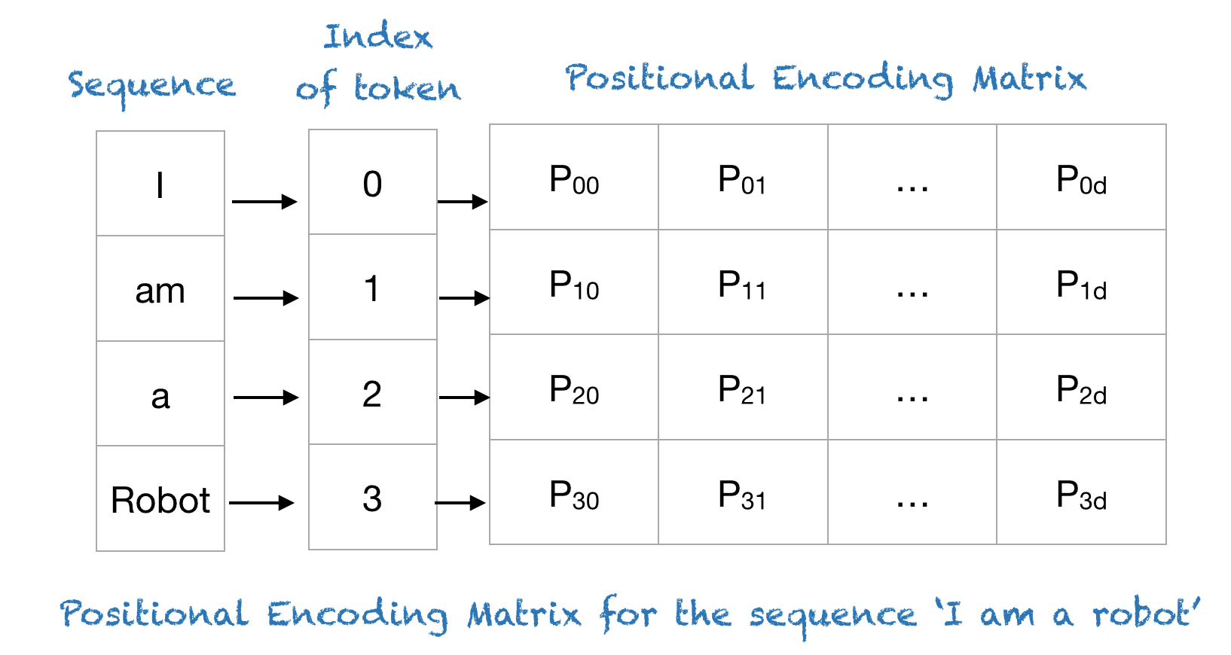
Positional Encoding Formula
pos: Position of an object in the input sequence, 0≤𝑘<𝐿/2
𝑑: Dimension of the output embedding space, here 512.
𝑛: User-defined scalar, set to 10,000 by the authors of Attention Is All You Need.
𝑖: Used for mapping to column indices 0≤𝑖<𝑑/2, with a single value of 𝑖 maps to both sine and cosine functions
In the above expression, you can see that even positions correspond to a sine function and odd positions correspond to cosine functions.
Reference: https://machinelearningmastery.com/a-gentle-introduction-to-positional-encoding-in-transformer-models-part-1/

Slide 7
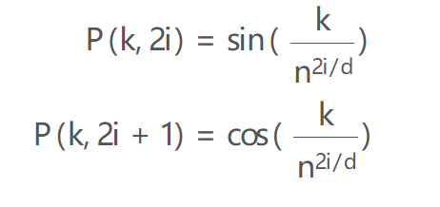
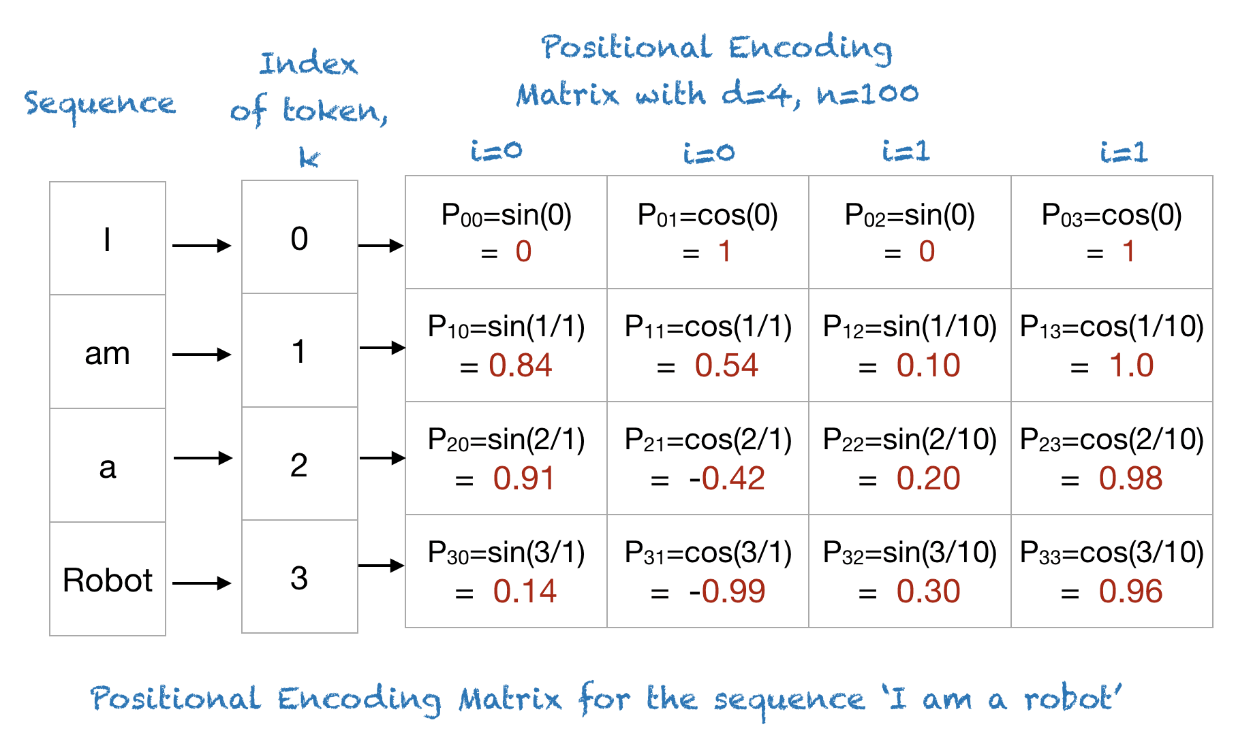
Positional Encoding Formula
Reference: https://machinelearningmastery.com/a-gentle-introduction-to-positional-encoding-in-transformer-models-part-1/

Slide 8
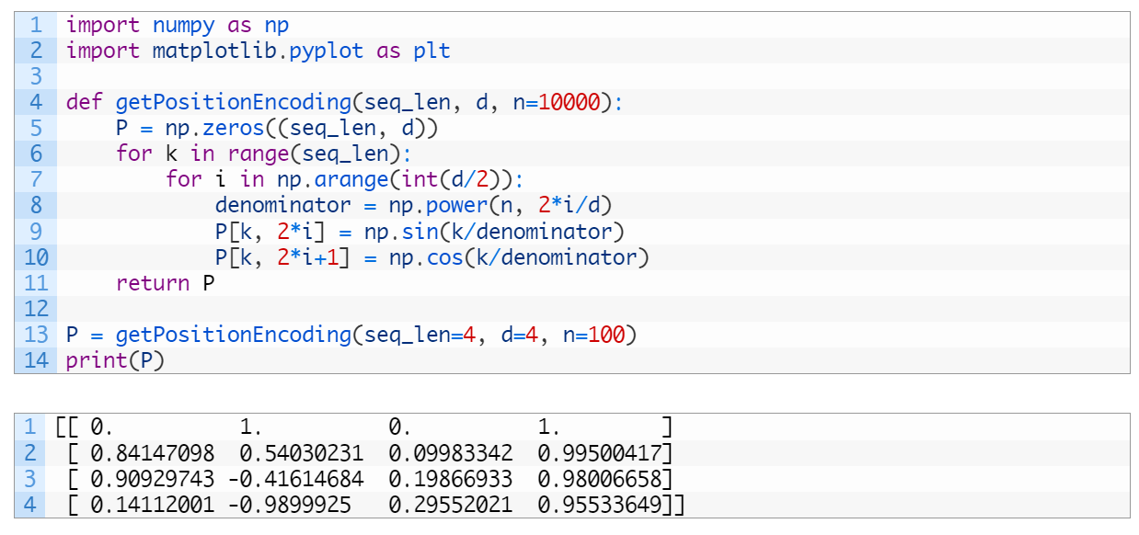
Positional Encoding Formula – Let’s code.
Reference: https://machinelearningmastery.com/a-gentle-introduction-to-positional-encoding-in-transformer-models-part-1/

Slide 9
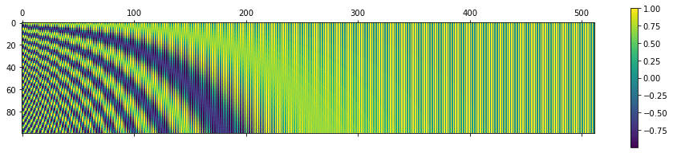
Visualize Positional Encoding Formula – Let’s code.
Reference: https://machinelearningmastery.com/a-gentle-introduction-to-positional-encoding-in-transformer-models-part-1/

Slide 10
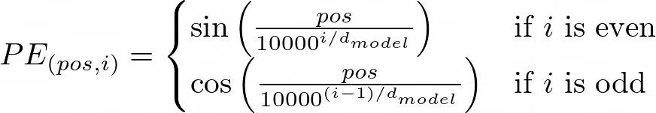
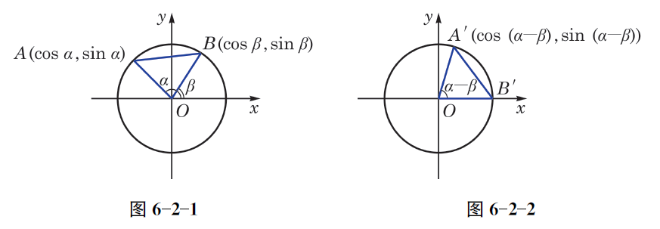
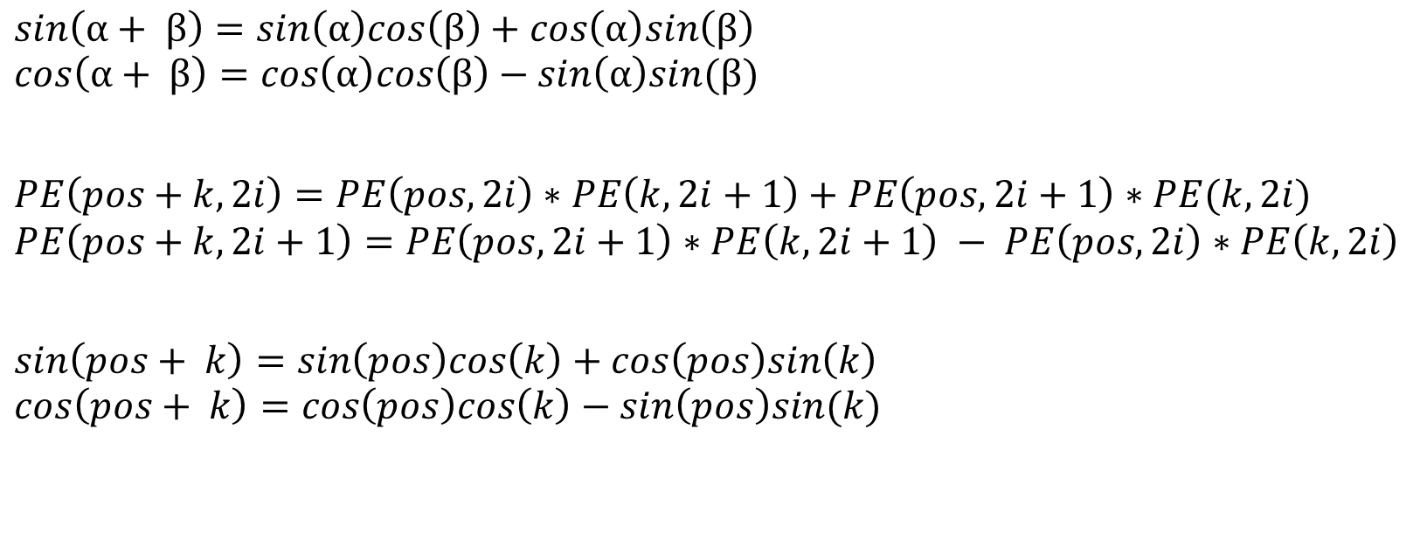
Linear Transformation – Let’s Go Deep.
$$sin\left(α+ β\right)=sin\left(α\right)cos\left(β\right)+cos\left(α\right)sin\left(β\right)$$
$$cos\left(α+ β\right)=cos\left(α\right)cos\left(β\right)−sin\left(α\right)sin(β)$$
$$PE\left(pos+k,2i\right)=PE\left(pos,2i\right)∗PE\left(k,2i+1\right)+PE\left(pos,2i+1\right)∗PE(k,2i)$$
$$PE\left(pos+k,2i+1\right)=PE\left(pos,2i+1\right)∗PE\left(k,2i+1\right) − PE\left(pos,2i\right)∗PE\left(k,2i\right)$$
$$sin\left(pos+ k\right)=sin\left(pos\right)cos\left(k\right)+cos\left(pos\right)sin\left(k\right)$$
$$cos\left(pos+ k\right)=cos\left(pos\right)cos\left(k\right)−sin\left(pos\right)sin(k)$$

Slide 11
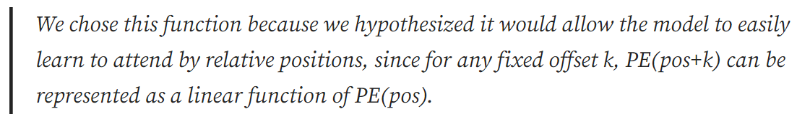
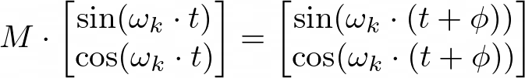

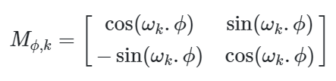
Linear Transformation – Let’s Go Deep.

Slide 12
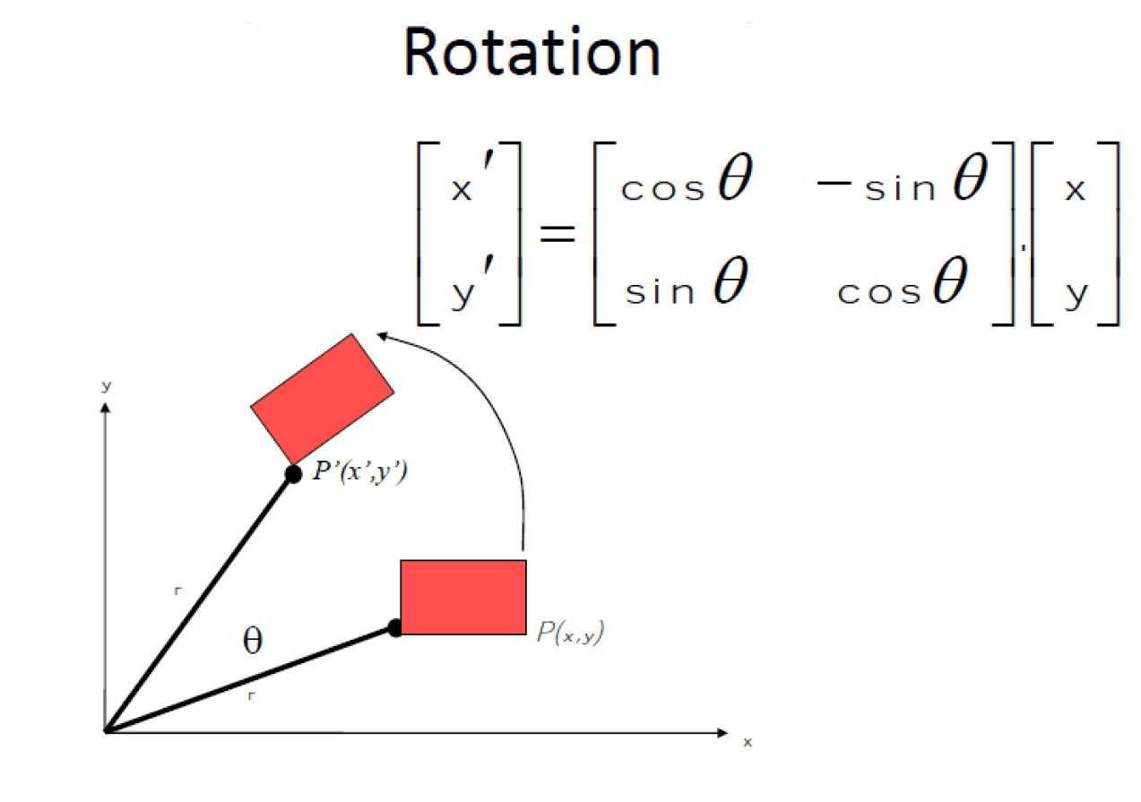
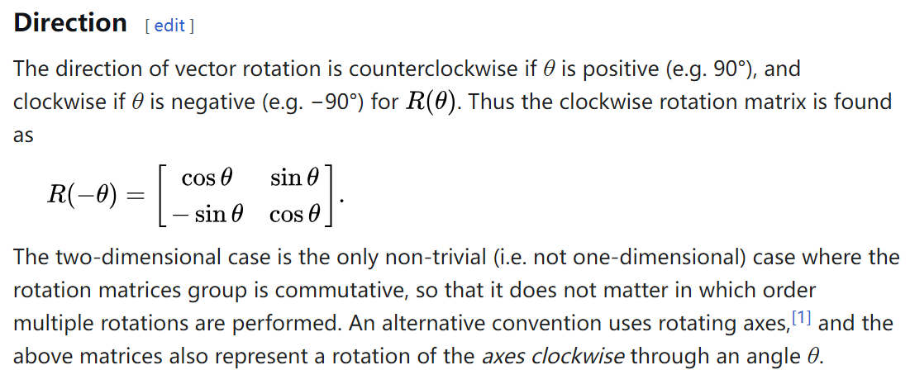
Linear Transformation – Let’s Go Deep.
https://en.wikipedia.org/wiki/Rotation_matrix
https://middletonlee1994.wordpress.com/2015/05/25/rotation-matrix/

Slide 13
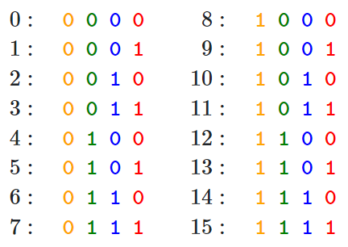
Fourier transform – Let’s Go Deeper.
The Intuition: From Bits to Waves
Binary Representation
Notice the pattern in how each bit (column) changes:
The rightmost bit (Least Significant Bit) alternates with every number (frequency: 1/2)
The second bit from the right alternates every two numbers (frequency: 1/4)
The third bit alternates every four numbers (frequency: 1/8) And so on…
This pattern of different frequencies is the key to positional encoding. But instead of using discrete bits, we can use something smoother: sine and cosine waves.
https://medium.com/thedeephub/positional-encoding-explained-a-deep-dive-into-transformer-pe-65cfe8cfe10b
https://kazemnejad.com/blog/transformer_architecture_positional_encoding/

Slide 14
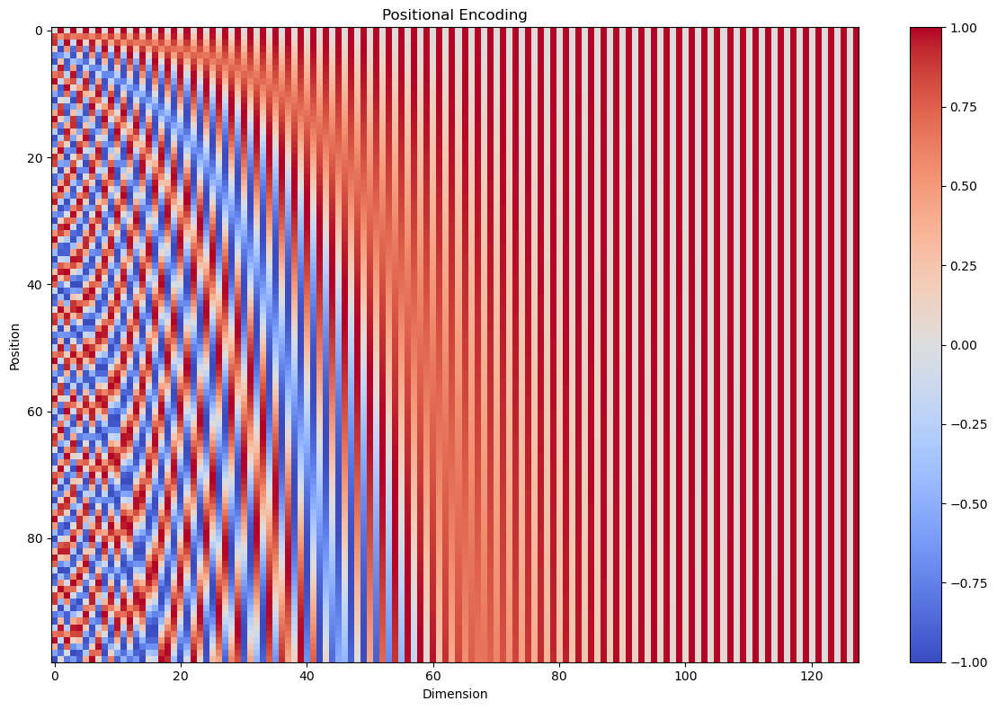
Fourier transform – Let’s Go Deeper.
The Intuition: From Bits to Waves
Sinusoidal Positional Encoding
This plot is analogous to our binary representation table, but with a continuous spectrum instead of discrete 0s and 1s:
1. Each row represents a token in the sequence, similar to how each row in our binary table represented a number. 2. Each column corresponds to a dimension in our tokens encoding, analogous to the bit positions in binary. 3. The colors represent values oscillating between -1 (blue) and 1 (red), which is a continuous version of the 0s and 1s in binary.
Key Observations:
— The first row (position 0) is like our binary “0000”, serving as the starting point. — As we move down the rows (increasing positions), we see patterns of color changes, similar to how bits flip in binary counting. — The leftmost columns (lower dimensions) change rapidly, like the least significant bits in binary. — The rightmost columns (higher dimensions) change more slowly, analogous to the most significant bits in binary.
https://medium.com/thedeephub/positional-encoding-explained-a-deep-dive-into-transformer-pe-65cfe8cfe10b

Slide 15
Fourier transform – Let’s Go Deeper.
The use of sine and cosine functions in sinusoidal positional encoding has a deep relationship with the Fourier transform. By using a range of different frequencies to encode positions, the Transformer creates a representation similar to a Fourier transform where:
High-frequency components (lower i) enable the model to capture local positional information. This is useful for understanding relationships between neighbor tokens in a sequence, such as word pairs.
Low-frequency components (higher i) capture more global patterns over the entire sequence. This helps the model to focus on broader relationships between tokens that may be far apart, such as dependencies between words in two different sentences.
This helps the model understand the relative positions of tokens by comparing their positional encodings. Sinusoidal positional encoding needs no additional training parameters while generalizing to larger sequence lengths at inference time. However, its expressiveness is limited.
https://towardsdatascience.com/beyond-attention-how-advanced-positional-embedding-methods-improve-upon-the-original-transformers-90380b74d324

Slide 16
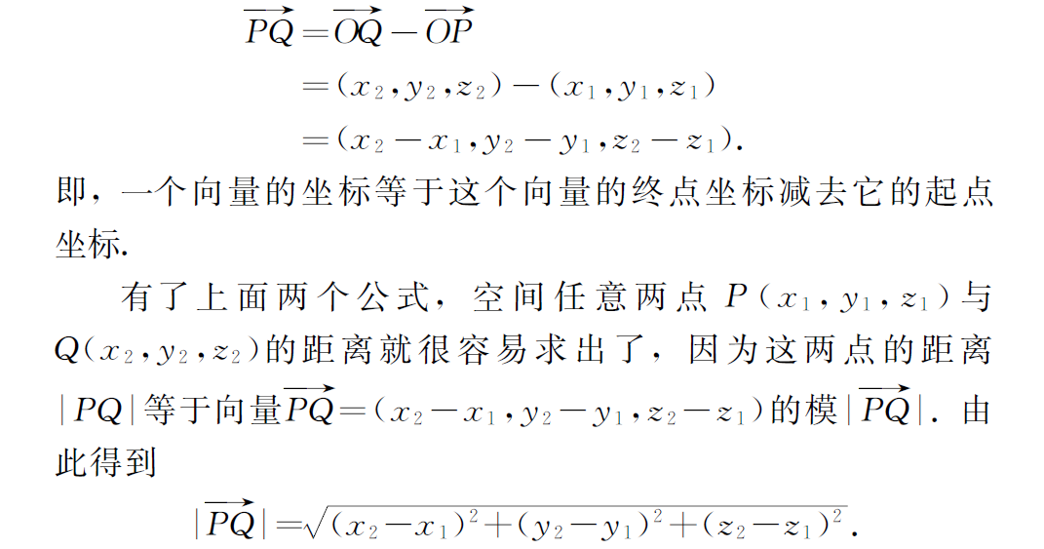
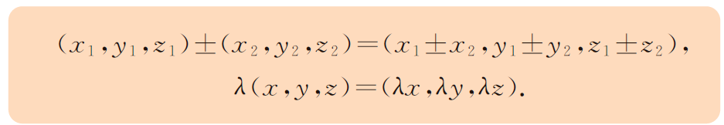
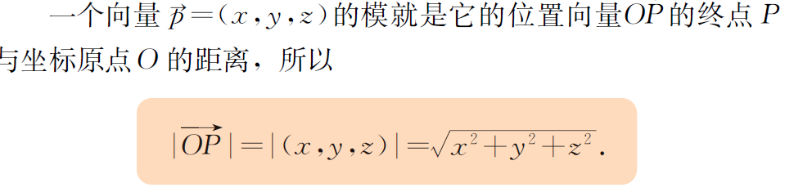
Euclidean Distance

Slide 17
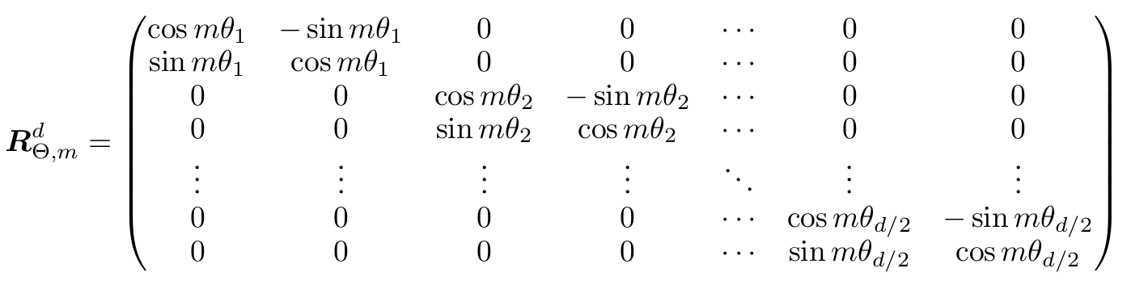
Further Study: RoPE
Roadmap of Positional Encoding:
Absolute Position Embedding:
1.a Sinusoidal Positional Encoding - Transformer
1.b Learned Positional Encoding – BERT and GPT
Relative Positional Embeddings
Rotary Positional Embedding (RoPE)
https://towardsdatascience.com/beyond-attention-how-advanced-positional-embedding-methods-improve-upon-the-original-transformers-90380b74d324
https://spaces.ac.cn/archives/8130

Slide 18



One more thing – the Great.
Su, Jianlin
Author of RoPE

Slide 19


Reference
Papers
Attention Is All You Need, 2017.
Reformer: Enhanced Transformer with Rotary Position Embedding, 2021 Books
普通高中教科书·数学必修 第二册， 上海教育出版社
普通高中教科书·数学选择性必修 第一册， 上海教育出版社
Hands-On Large Language Models: Language Understanding and Generation, 2024, by Jay Alammar, Maarten Grootendorst
Articles
A Gentle Introduction to Positional Encoding in Transformer Models
Positional Encoding Explained: A Deep Dive into Transformer PE
Transformer Architecture: The Positional Encoding
Transformer升级之路：1、Sinusoidal位置编码追根溯源
Trigonometric functions, Sine and cosine, Rotation matrix, Fourier transform, Euclidean distance in Wikipedia Videos
Transformer之位置编码Positional Encoding （为什么 Self-Attention 需要位置编码）

